Slide 1
Apache Kafka Architecture – Cluster
Kafka Cluster Diagram
Kafka Ecosystem
Kafka Cluster
Consumer Group
Producer1
Broker1
Consumer1
Push Message
Pull Message
Producer2
Broker2
Consumer2
Broker3
Producer3
Consumer3
Broker4
Get Kafka Broker Id
Updates Offset
Zoo Keeper

Slide 2
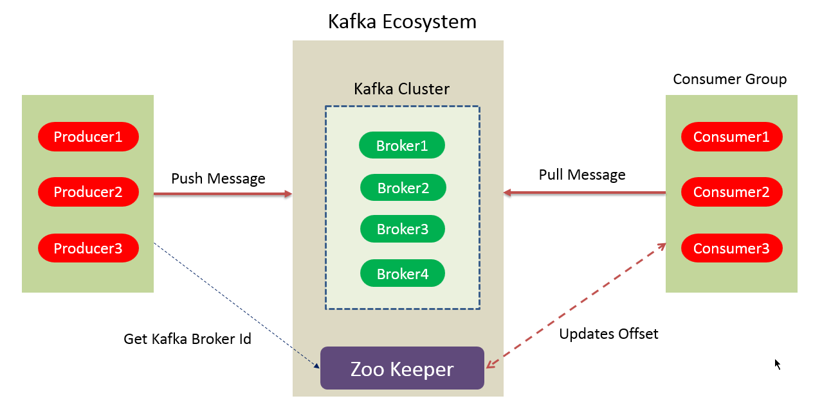
Apache Kafka Architecture – Cluster
Kafka Broker:
Kafka cluster typically consists of multiple brokers to maintain load balance.
Kafka brokers are stateless, so they use ZooKeeper for maintaining their cluster state.
One Kafka broker instance can handle hundreds of thousands of reads and writes per second and each broker can handle TB of messages without performance impact.
Kafka broker leader election can be done by ZooKeeper.

Slide 3
Apache Kafka Architecture – Cluster
Kafka – ZooKeeper:
ZooKeeper is used for managing and coordinating Kafka broker.
ZooKeeper service is mainly used to notify producer and consumer about the presence of any new broker in the Kafka system or failure of the broker in the Kafka system. As per the notification received by the Zookeeper regarding presence or failure of the broker then producer and consumer takes decision and starts coordinating their task with some other broker.

Slide 4
Apache Kafka Architecture – Cluster
Kafka Producers:
Producers push data to brokers.
Kafka producer doesn’t wait for acknowledgements from the broker and sends messages as fast as the broker can handle.
When the new broker is started, all the producers search it and automatically sends a message to that new broker.

Slide 5
Apache Kafka Architecture – Cluster
Kafka Consumers:
Since Kafka brokers are stateless, which means that the consumer has to maintain how many messages have been consumed by using partition offset.
If the consumer acknowledges a particular message offset, it implies that the consumer has consumed all prior messages.
The consumer issues an asynchronous pull request to the broker to have a buffer of bytes ready to consume. The consumers can rewind or skip to any point in a partition simply by supplying an offset value. Consumer offset value is notified by ZooKeeper.

Slide 6
Apache Kafka Architecture – Cluster
Consumer Group:
In a queue messaging system instead of a single consumer, a group of consumers having the same Group ID will subscribe to a topic. In simple terms, consumers subscribing to a topic with same Group ID are considered as a single group and the messages are shared among them

Slide 7

Apache Kafka Architecture – Cluster
Kafka Topics
Relation between Kafka Topics and Partitions
Topic
Partition 0
1 | 2 | 3 | 4 | 5 | 6 | 7
Partition 1
1 | 2 | 3 | 4 | 5 | 6
Writes
Partition 2
1 | 2 | 3 | 4 | 5 | 6 | 7
Messages are written to Topics and Kafka randomly selects which Partition to write the message to.(unless message has any key)
Topic may contain any number of Partitions
Partition wise offset will increment

Slide 8
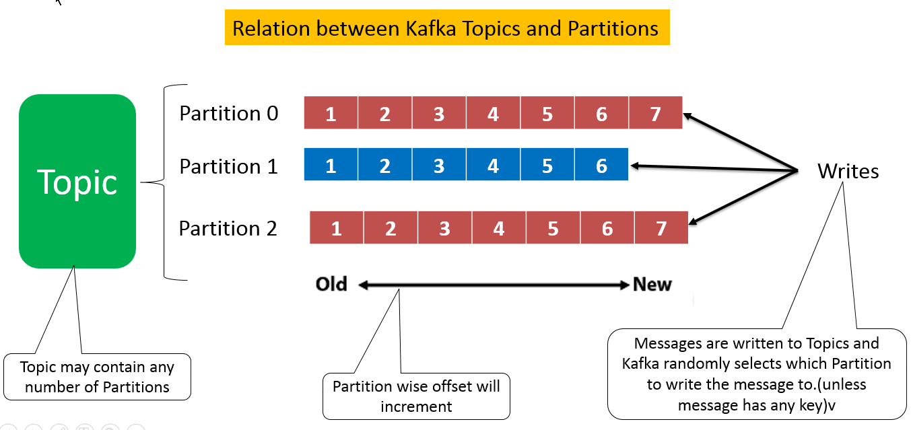
Apache Kafka Architecture – Cluster
Kafka Topics
A stream of messages belonging to a particular category is called a topic. Data is stored in topics.
Topics are split into partitions.
For each topic, Kafka keeps a minimum of one partition. Each such partition contains messages in an immutable ordered sequence.
A partition is implemented as a set of segment files of equal sizes.

Slide 9
Apache Kafka Architecture – Cluster
Partitions in Kafka
Topics may have many partitions, so it can handle an arbitrary amount of data.
Partition offset - Each partitioned message has a unique sequence id called as offset.

Slide 10
Apache Kafka Architecture – Cluster
Topic Replication Factor in Kafka
While designing a Kafka system, it’s always a wise decision to factor in topic replication. As a result, its topics’ replicas from another broker can solve the crisis, if a broker goes down. For example, we have 3 brokers and 3 topics.
Broker1 has Topic 1 and Partition 0, its replica is in Broker2, so on and so forth. It has got a replication factor of 2; it means it will have one additional copy other than the primary one.
Broker 1
Broker 2
Broker 3
Topic A
Partition 0
Replication
Topic A
Partition 1
Replication
Topic A
Partition 1
Topic B
Partition 1
Topic A
Partition 0
Topic B
Partition 1
Replication
Leader
Replica

Slide 11
Apache Kafka Architecture – Cluster
Topic Replication Factor in Kafka
Replication takes place in the partition level only.
For a given partition, only one broker can be a leader, at a time. Meanwhile, other brokers will have in-sync replica; what we call ISR.
It is not possible to have the number of replication factor more than the number of available brokers.
Leader - Leader is the node responsible for all reads and writes for the given partition. Every partition has one server acting as a leader.
Follower - Node which follows leader instructions are called as follower. If the leader fails, one of the follower will automatically become the new leader. A follower acts as normal consumer, pulls messages and up-dates its own data store.
Broker 1
Broker 2
Broker 3
Topic A
Partition 0
Replication
Topic A
Partition 1
Replication
Topic A
Partition 1
Topic B
Partition 1
Topic A
Partition 0
Topic B
Partition 1
Replication
Leader
Replica

